Slide 1
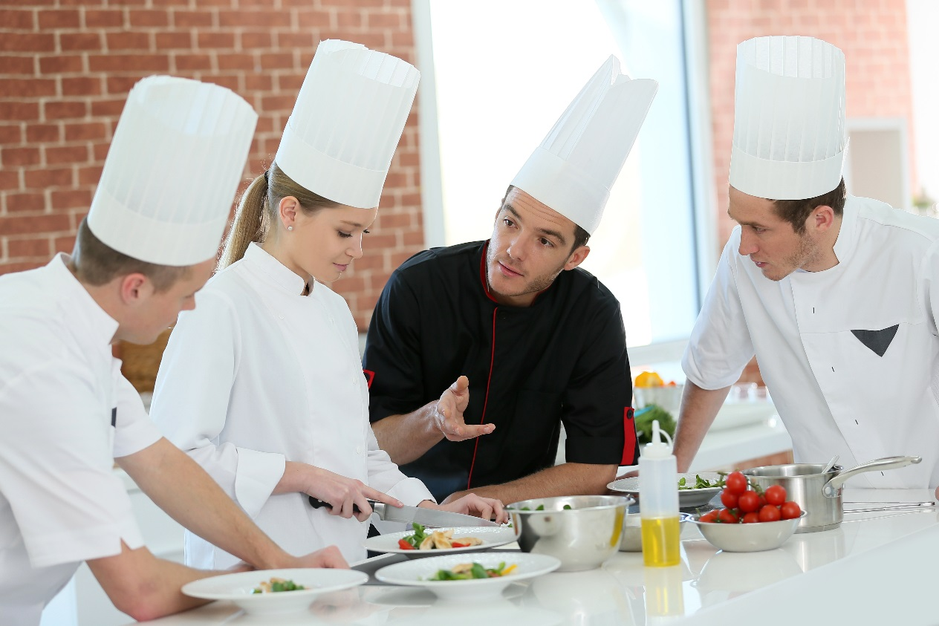
Food Safety Facts: Bingo
PUB-0011-201806
CC BY-NC-SA 4.0
Notes:
This bingo game is designed to replace Part 2: Keeping Food Safe of the Alberta Food Safety Facts main PowerPoint presentation, except for the handwashing and hygiene section. You can start to play bingo after you have completed Part 1: Foodborne Illness of the Alberta Food Safety Facts main PowerPoint presentation.
This presentation holds a Creative Commons License: Attribution-NonCommercial-ShareAlike 4.0 International. Please see the next slide for more information.

Slide 2

©2018 Alberta Health Services, Knowledge Management.
This work is licensed under a Creative Commons Attribution-Non-commercial-Share Alike 4.0 International license. You are free to copy, distribute and adapt the work for non-commercial purposes, as long as you attribute the work to Alberta Health services and abide by the other licence terms. If you alter, transform, or build upon this work, you may distribute the resulting work only under the same, similar, or compatible licence. The licence does not apply to content for which the Alberta Health Services is not the copyright owner. To view a copy of this licence, see https://creativecommons.org/licenses/by-nc-sa/4.0/
This material is intended for general information only and is provided on an “as is”, “where is” basis. Although reasonable efforts were made to confirm the accuracy of the information, Alberta Health Services does not make any representation or warranty, express, implied or statutory, as to the accuracy, reliability, completeness, applicability or fitness for a particular purpose of such information. This material is not a substitute for the advice of a qualified health professional. Alberta Health Services expressly disclaims all liability for the use of these materials, and for any claims, actions, demands or suits arising from such use.
Notes:
Copyright and Disclaimer information

Slide 3

Food Safety Bingo
Listen to the food safety questions.
10 seconds to decide for each answer, then we will discuss.
Tick the square that contains the answer.
Once you have completed the picture frame, yell Bingo!

Slide 4
What are the danger zone temperatures where bacteria grow quickly?

Slide 5
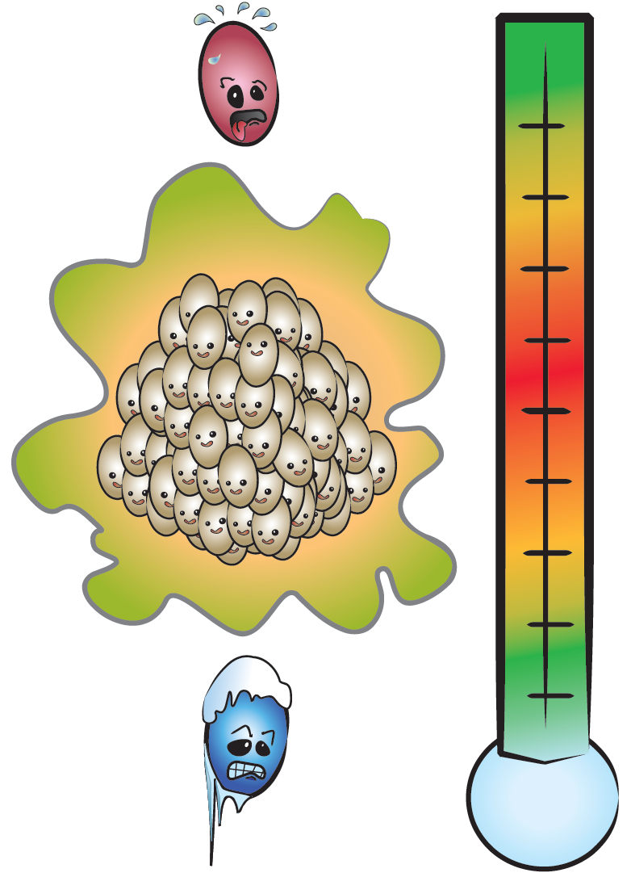

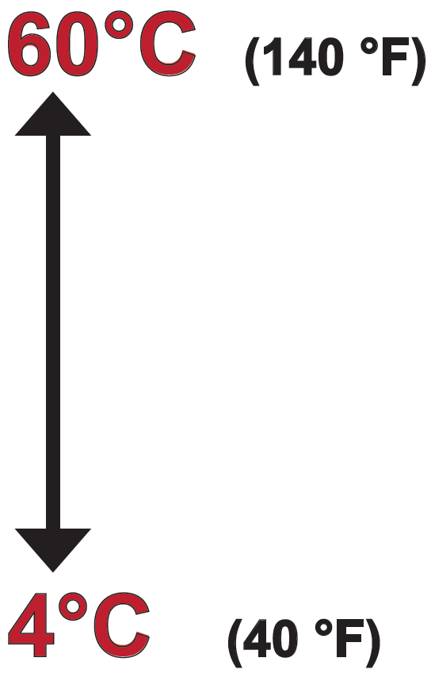
Temperature Danger Zone
Notes:
Answer: 4°C - 60°C
When considering that hot food should be kept hot and cold food should be kept cold, it is important to know the Temperature Danger Zone which is the range of temperatures at which bacteria can multiply rapidly to make food unsafe in a short time period. To keep foods hot, keep them at or above 60°C so that bacteria don’t grow and to keep foods cold, keep them at or below 4°C so that bacterial growth is slowed down. The closer the food temperature is to the middle of the danger zone, the faster bacteria can multiply. Ideal temperatures for bacterial growth range from 30 – 45°C. At these temperatures, bacteria can divide into two every 20 minutes. Please note that kitchen temperature often reaches the middle of the danger zone.
Figure © AHS EPH

Slide 6
How long can potentially hazardous foods be left in the danger zone?

Slide 7
Time = 2 Hours or Less
When do you work with food in the danger zone?
How warm does your kitchen get?
Limit time of temperature abuse:
  No more than 2 hours in Danger Zone
Notes:
7
The longer you keep potentially hazardous foods in the “danger zone,” the greater the risk. The rule to use is to minimize the time potentially hazardous foods are in the danger zone to no more than 2 hours.
Note: Time spent in the danger zone does not have to be continuous.

Slide 8

Bacterial Cell Division
If bacteria can divide in two every 20 minutes…
1 bacteria left at
room temperature for 7 hours will produce…
Notes:
Usually there are more than one bacterial cell in food so it doesn’t take long to get high levels of bacteria in a short while, in a real life scenario.
Figure © AHS EPH

Slide 9


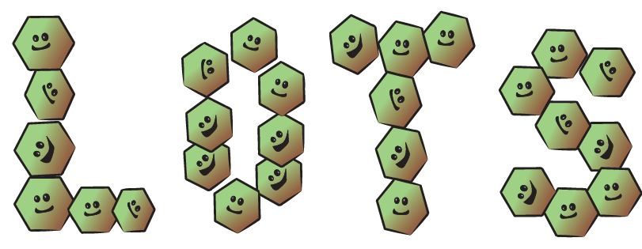


2,097,152 Bacteria Cells
Notes:
Figure © AHS EPH

Slide 10
Food must be cooked to what temperature to make sure it is safely cooked?

Slide 11
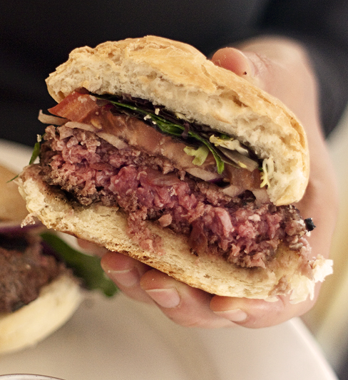
Cook foods thoroughly.
Cooking
minimum internal temperature of 74°C for 15 seconds
Notes:
Answer: 74°C
The cooking temperature of foods is important to kill pathogens. An internal cooking temperature of 74°C (165°F) for 15 seconds will kill pathogens in food.
Question:
How can we tell when food is done cooking? (Answer on next slide)
Additional Information:
The above picture shows an undercooked hamburger. Pathogens such as E. coli may be found throughout the hamburger and could cause easily cause illness if eaten.
http://www.healthycanadians.gc.ca/eating-nutrition/healthy-eating-saine-alimentation/safety-salubrite/tips-conseils/cook-temperatures-cuisson-tbl-eng.php
http://befoodsafe.ca/be-food-safe/4-simple-steps-clean-separate-cook-chill/
http://befoodsafe.ca/wp-content/uploads/2013/08/cook.pdf

Slide 12
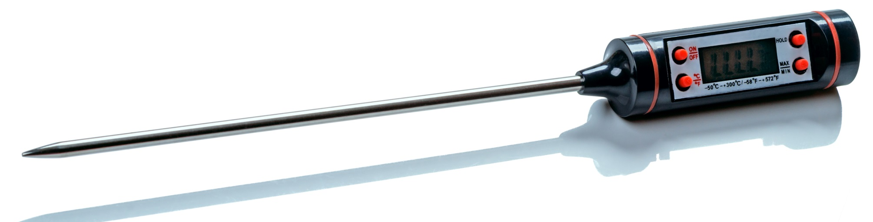
Thermometers
Thermometers are the only sure way to know if a food is safely cooked.
Measure inside the thickest part of the food.
Notes:
Answer (from previous slide):
Using a probe thermometer to measure internal temperatures is the only reliable way to know that a food is safely cooked. When using a probe thermometer, insert the probe into the thickest part of the food. The thickest part of the food will be the last to cook or the last to cool. Avoid parts of the food with large bones as this affects the temperature reading.
Additional Information:
Thermometer calibration: http://www.albertahealthservices.ca/assets/wf/eph/wf-eh-thermometer-calibration.pdf

Slide 13
The color of food while it is cooking tells you what?

Slide 14
Color Means Nothing
1 out of 4 hamburger patties turn brown before fully cooked.
  Sometimes patties that are still pink inside may be safely cooked.
  “Juices run clear” and “piping hot” don’t mean the food is safe to eat.
Notes:
Answer: nothing
We often look at the color and texture of a food to ensure it is safely cooked but color is not a reliable indicator of safety. A large study done on several hundred hamburgers determined that one in four hamburgers turned brown before it was safely cooked to kill pathogens.
https://www.fsis.usda.gov/wps/wcm/connect/fsis-content/internet/main/topics/food-safety-education/get-answers/food-safety-fact-sheets/meat-preparation/color-of-cooked-ground-beef-as-it-relates-to-doneness/ct_index

Slide 15
What is one of the most common mistakes food handlers make that results in food poisoning?

Slide 16
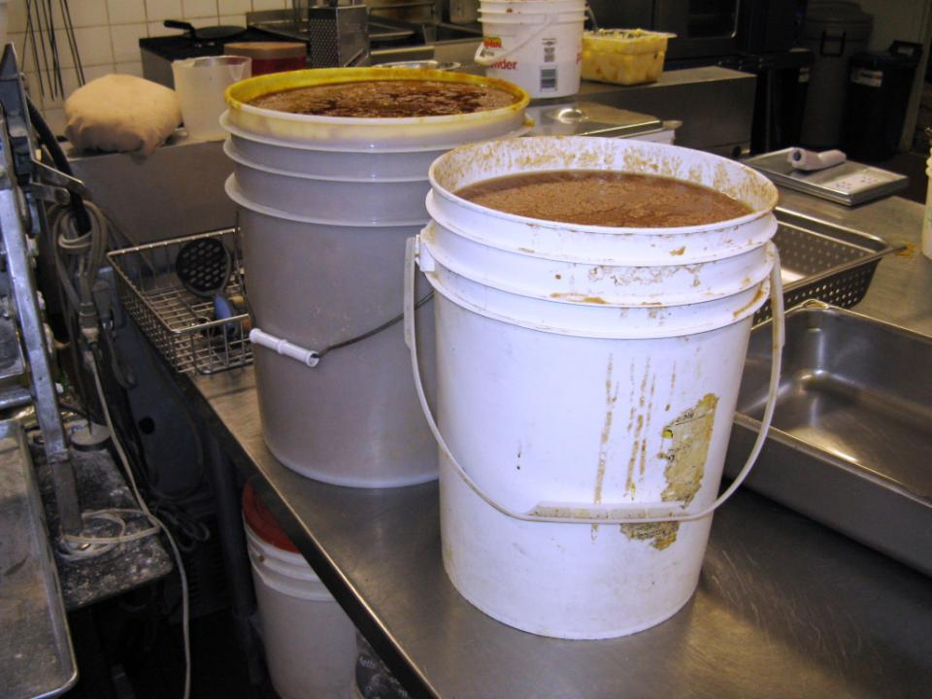
Cool Down Hot Foods Quickly
Improper cooling is a common cause of outbreaks.
Cool hot foods as quickly as possible to 4°C (within 4 – 6 hours).
The larger the volume of hot food, the longer it takes to cool.
Notes:
Not cooling foods properly is a common cause of foodborne illness outbreaks. It is important to cool foods as quickly as possible to limit the growth of pathogens as the food goes through the Danger Zone. The food handler should ensure that the food temperature reaches 4°C within 4 to 6 hours.
When cooling food, the larger the volume of hot food, the longer it takes to cool.

Slide 17
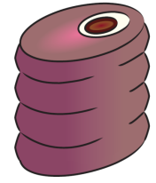
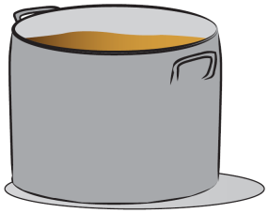



Cooling
Break food down into smaller volumes.
Notes:
To help food cool more quickly, reduce portion size, such as cutting a large roast into smaller pieces. For liquid foods such as stews, sauces or soups, transfer the foods to shallow metal pans and place in the fridge.
Additional Information:
Shallow = more surface area; metal = conducts heat quickly
Figures © AHS EPH

Slide 18
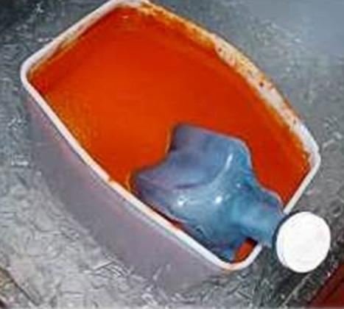
Cooling
use ice
  ice bath
  ice paddle
  ice as an ingredient
keep uncovered
stir
Notes:
Other ways to cool food more quickly are to use ice such as:
1. Fill a sink or large container with ice and water to make an ice bath.
2. Use an ice wand or ice paddle, which is a device that allows you to freeze water in the shape of a stirring tool.
3. Use ice as an ingredient.
Hot foods should not be covered while they are trying to cool as covering the food retains the heat. Any hot food will cool faster when it is stirred often.

Slide 19
What is fridge temperature?

Slide 20
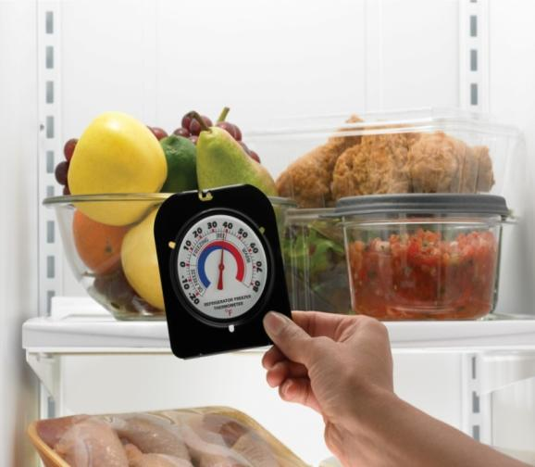
Keep Cold Foods Cold
Cold holding requires temperature ≤ 4°C.
Notes:
Answer: 4°C
Refrigeration or cold holding of potentially hazardous foods will slow the growth of pathogenic bacteria or spoilage organisms that are present. However, cold temperatures do not usually kill microorganisms. This means that refrigerated foods can still spoil or become dangerous, it just takes longer. When using ice or refrigeration equipment for cold holding, the internal temperature of the food must be 4°C (40°F) or colder.
Additional Information:
http://befoodsafe.ca/be-food-safe/4-simple-steps-clean-separate-cook-chill/
http://befoodsafe.ca/wp-content/uploads/2013/08/chill.pdf

Slide 21
What minimum temperature should food in a hot buffet/steam table be?

Slide 22
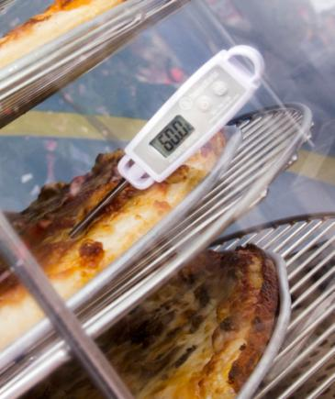
Keep Hot Foods Hot
Hot holding requires temperature ≥ 60°C.
Notes:
Answer: 60°C
Hot holding is needed if cooked foods are not going to be served right away, but within a few hours, or for buffet style service. The food is kept hot on cooking equipment (e.g. stovetop, oven, etc) or foods are placed in hot holding equipment (e.g. steam table, pizza carousel, crock pot, rice warmer, etc). Foods that are being held hot for any period of time must be kept at 60°C (140°F) or hotter. Pathogens will not grow or multiply at this temperature. This means the food can be kept at 60°C for long periods of time but the food texture and taste may be impacted.
Photo: © AHS EPH

Slide 23
Where is the safest place to thaw food?

Slide 24
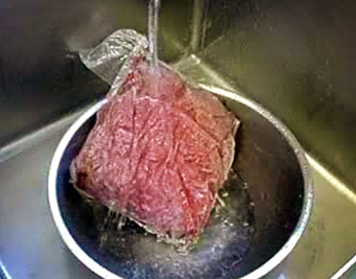
Thawing
Thawing requires temperature control!
refrigerator
cool, running water
cook from frozen
microwave
Notes:
Answer: refrigerator
Thawing frozen foods is a process that requires temperature control. Depending on the food size and shape, parts of the food can thaw quickly and be in the Danger Zone for long periods of time before the rest of the food is thawed. Foods should be thawed:
in the refrigerator at 4°C
under cool, running water in a sink
some frozen foods can be cooked from frozen (e.g. frozen hamburger patties, frozen vegetables, soup, etc.)
if a microwave is used to quickly thaw frozen foods, the food should be cooked immediately
Don’t thaw food at room temperature as the food will be in the Danger Zone for more than 2 hours.

Slide 25
How quickly and to what temperature should food be reheated to?

Slide 26
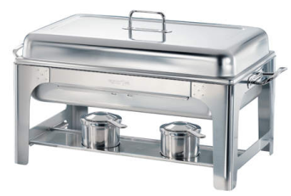
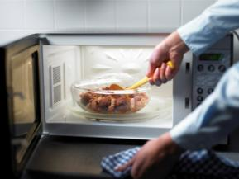
Reheat Cold Foods Quickly
Reheat foods to ≥ 74°C within 2 hours or less.
Do not use hot holding
equipment to reheat.
Only reheat one time.
Notes:
Answer: 74°C within 2 hours
Food should be reheated to at least 74°C within 2 hours. Food should only be reheated one time to maintain food quality and reduce the risk of pathogen growth that can occur from frequent reheating and cooling.
Additional Information:
Top picture = a hot holding pan. This and similar equipment (e.g. steam table) should not be used to REHEAT food.
Bottom picture = you can use the microwave to quickly reheat cold foods.
http://www.healthycanadians.gc.ca/eating-nutrition/healthy-eating-saine-alimentation/safety-salubrite/tips-conseils/cook-temperatures-cuisson-tbl-eng.php
http://befoodsafe.ca/be-food-safe/4-simple-steps-clean-separate-cook-chill/
http://befoodsafe.ca/wp-content/uploads/2013/08/cook.pdf

Slide 27
How do animals often contaminate food like meat and chicken?

Slide 28
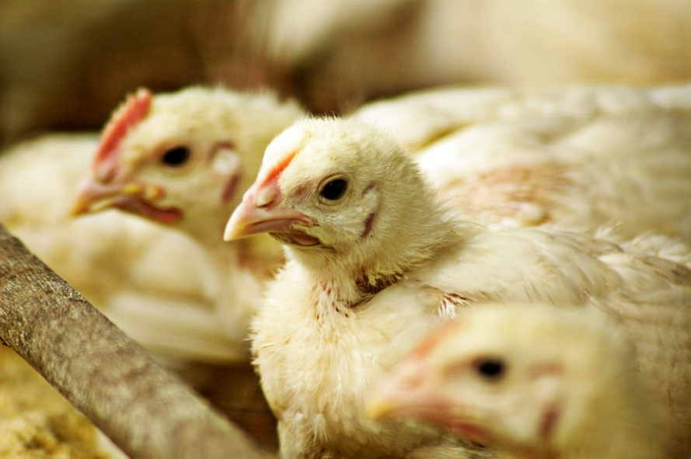
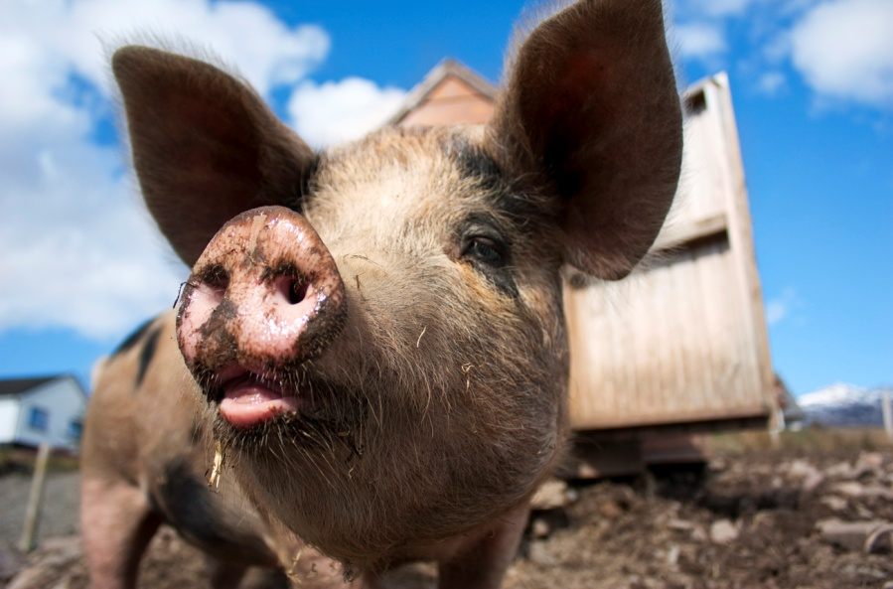
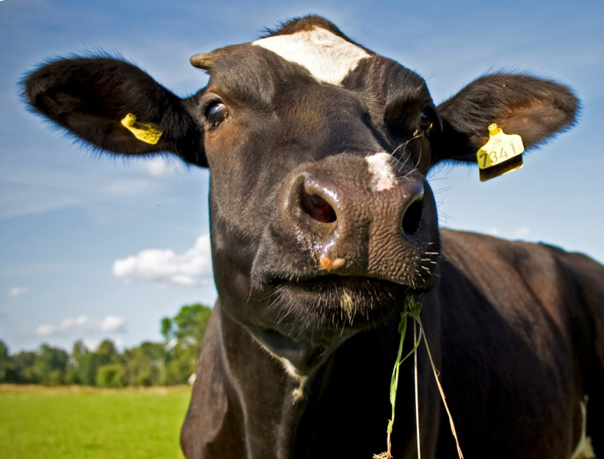
Animals = Poop…
Photo:garwee@sxc.hu
Notes:
28
Answer: poop
Animals can carry microorganisms in their intestinal tract. For example:
Many animals and birds carry Salmonella and other bacteria.
Cattle carry E. coli on their hide and fecal matter.
Photo : pig by garwee@sxc.hu

Slide 29
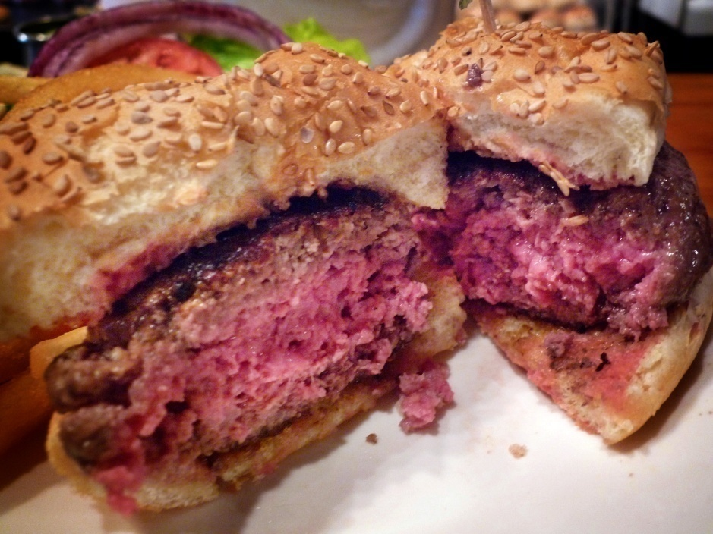
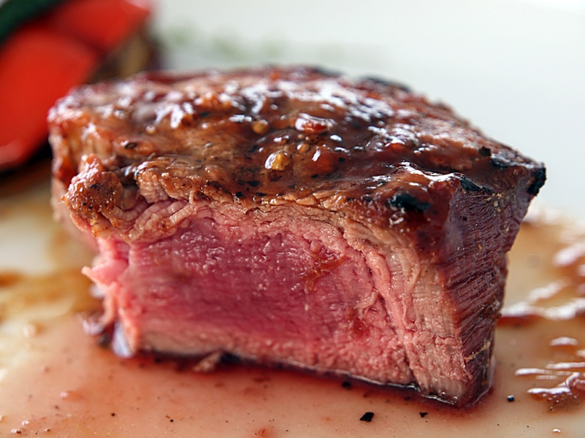
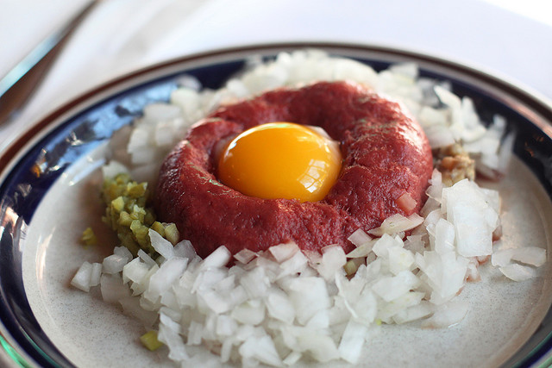
Whole vs. Ground Meats?
Photo: Wonggawei@flickr.com
Photo: rockdoggydog@flickr.com
Notes:
Normally, whole cuts of meat are only contaminated on the outside but ground meat products and meats that are mechanically tenderized, can have pathogens transferred to the inside of the meat through the process of grinding or tenderizing. This is why all ground meats and mechanically tenderized meat must be thoroughly cooked (i.e. no rare hamburgers).
Steak tartare is a raw beef food item. It is usually prepared from a single whole piece of choice cut sirloin, minced or ground when order is placed, and is served with raw egg yolk and condiments. Steak tartare is a high risk food because it is raw animal protein.
Raw hamburger: wonggawei@Flickr.com (Creative Commons License)
Steak tartare: rockdoggydog@flickr.com (Creative commons license)
Rare Steak : Free stock @ stock xchng

Slide 30
Finish the sentence: When in doubt......................................

Slide 31
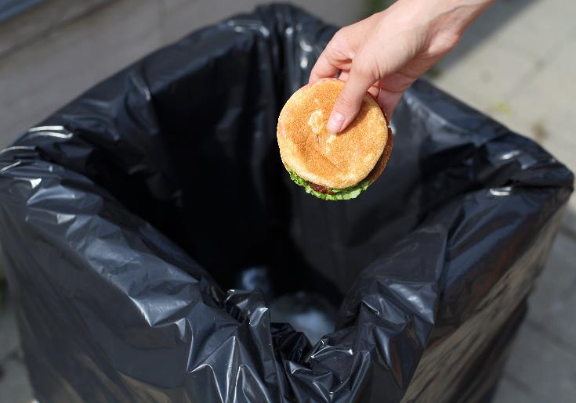
When in Doubt, Throw it Out
Don’t guess about food safety.
Better to be cautious than risk making customers sick.
Notes:
Answer: throw it out
When it comes to serving food to customers, family and friends, don’t take chances with food that may potentially be unsafe.

Slide 32
What is left on the surface after cleaning it with soap and water?

Slide 33
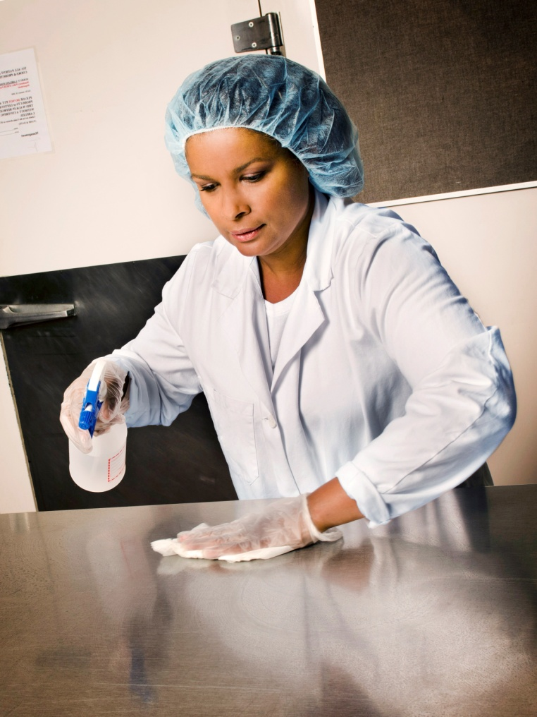
Cleaning
Cleaning removes dirt and food debris from surfaces.
Plenty of pathogens survive cleaning.
Notes:
Answer: plenty of pathogens
Cleaning removes dirt and food debris on surfaces but pathogens may still exist even after thorough cleaning.

Slide 34
This is done after cleaning to reduce the number of pathogens left on a surface to a safe level?

Slide 35
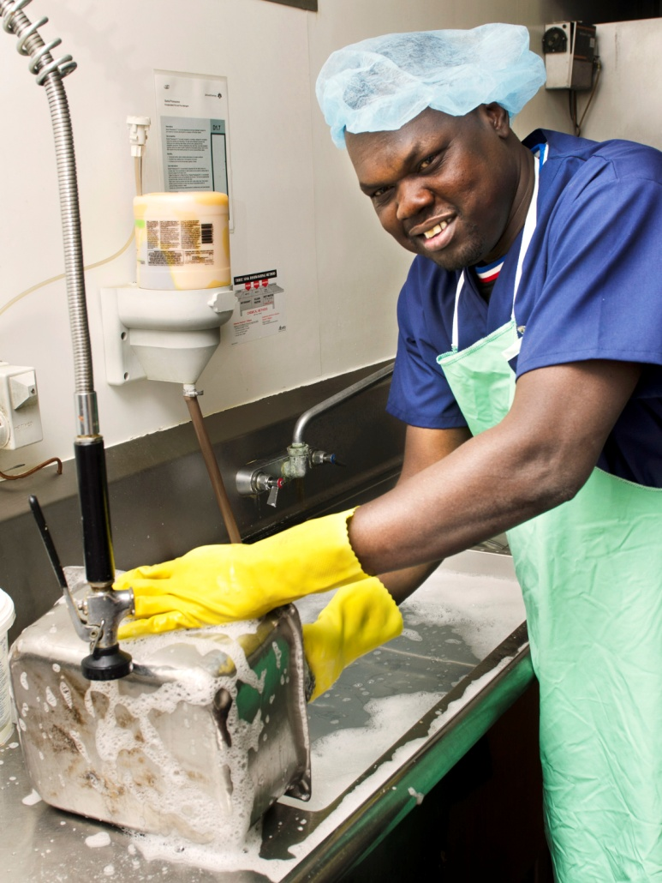
Sanitizing
Sanitizing:
Reducing pathogens to a safe level, using heat or a chemical.
Notes:
Answer: sanitizing

Slide 36
An easy sanitizer to make at home is a bleach solution. How much bleach do you need to add to one liter of water to make a food-grade sanitizer?

Slide 37
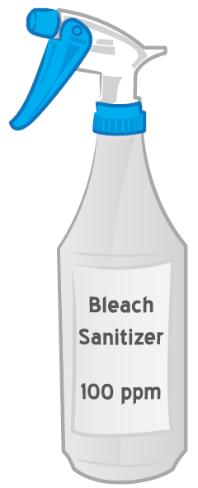
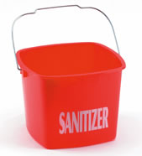
A Simple Sanitizing Solution
bleach and water
  ½ teaspoon of bleach in 1 L of water
Cloths should be stored in a bucket with sanitizing solution.
Notes:
Answer: ½ a teaspoon
You can easily make a cheap and effective sanitizer by adding ½ teaspoon of non-concentrated bleach to 1 liter of water. If you are using a reusable cloth to sanitize, it must be stored in a sanitizing solution in order to keep it from being a source of cross-contamination.

Slide 38
How should fruits and vegetables be washed?

Slide 39
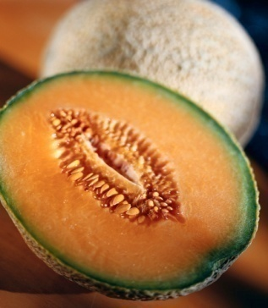
Washing Fruits and Vegetables 14: 1 of 1
Wash produce under cool, running water.
Notes:
Answer: under cool, running water
There is no need to use soap or other type of chemical to wash fruits and vegetables. Make sure your hands are clean and use friction to help clean the produce. You should always wash produce before cutting it.

Slide 40
Nails should always be…………… and ……………………..

Slide 41
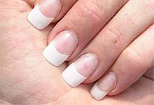
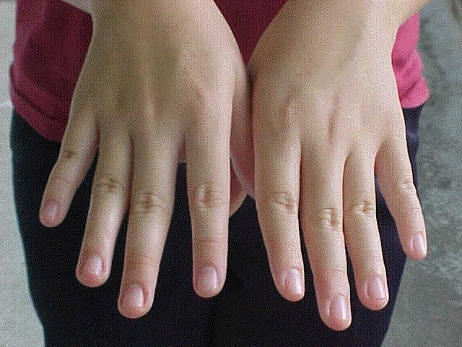
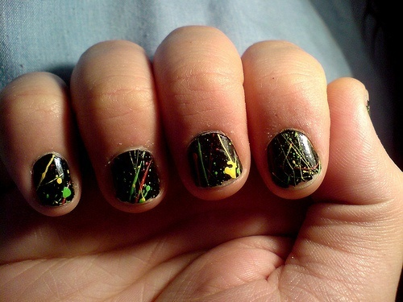
Fingernails
Nails should be short and clean
borispumps@flickr.com
Notes:
Answer: short and clean
Nails should be short and clean.
Do not wear jewellery, nail polish or fake nails.

Slide 42
When washing dishes by hand, you first wash with hot soapy water, rinse with clean water, sanitize and then............?

Slide 43
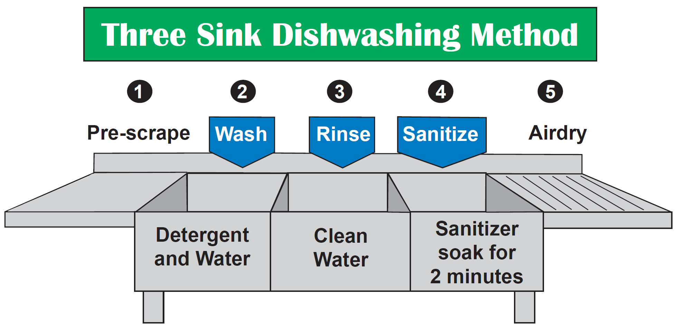
Dishwashing by Hand
Water temp = 45°C
Notes:
Answer: airdry
Dishwashing in a commercial kitchen requires the additional step of sanitizing which is followed up by air drying. There is typically a third sink to easily complete the steps for dishwashing.
Step #1: pre-rinse and pre-scrape to remove large amounts of debris, grease, burnt or baked on food
Step #2: wash in detergent and warm water
Step #3: rinse away soap with clean water
Step #4: sanitize using either a chemical or really hot water (77°C) for at least 2 minutes as the effectiveness of the sanitizer depends on the contact time
Step #5: air dry
Additional Information:
Change water frequently.
When suds disappear in the first compartment, refresh with clean water and soap.
When water in second compartment becomes sudsy, refresh with clean rinse water.
Use test strips to ensure concentration of chemical sanitizer in last compartment remains at minimum concentration (100 ppm for chlorine bleach, 200 ppm for quats).
Figure © AHS EPH

Slide 44
What is one of the most germy things found in a kitchen?

Slide 45
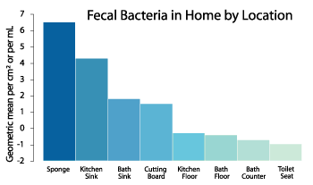
Contamination in the home
Notes:
Answer: kitchen sponge
The kitchen sponge is the most germy things in your house. This is because sponges contain food, water and are kept warm. These conditions allow bacteria to grow quickly in the sponge. A dirty sponge contains more fecal bacteria than your kitchen sink, cutting board or even your toilet!
As you can see in the graph, the kitchen sink and cutting board also contain high numbers of fecal bacteria. Make sure to keep your sink and cutting board clean and dry.
Additional Information:
See page 9 of this document: http://www.nsf.org/newsroom_pdf/2011_NSF_Household_Germ_Study_exec-summary.pdf
Graph from Dr. Charles Gerba (“Dr. Germ”).
http://www.purebrush.com/UniArizona.php

Slide 46
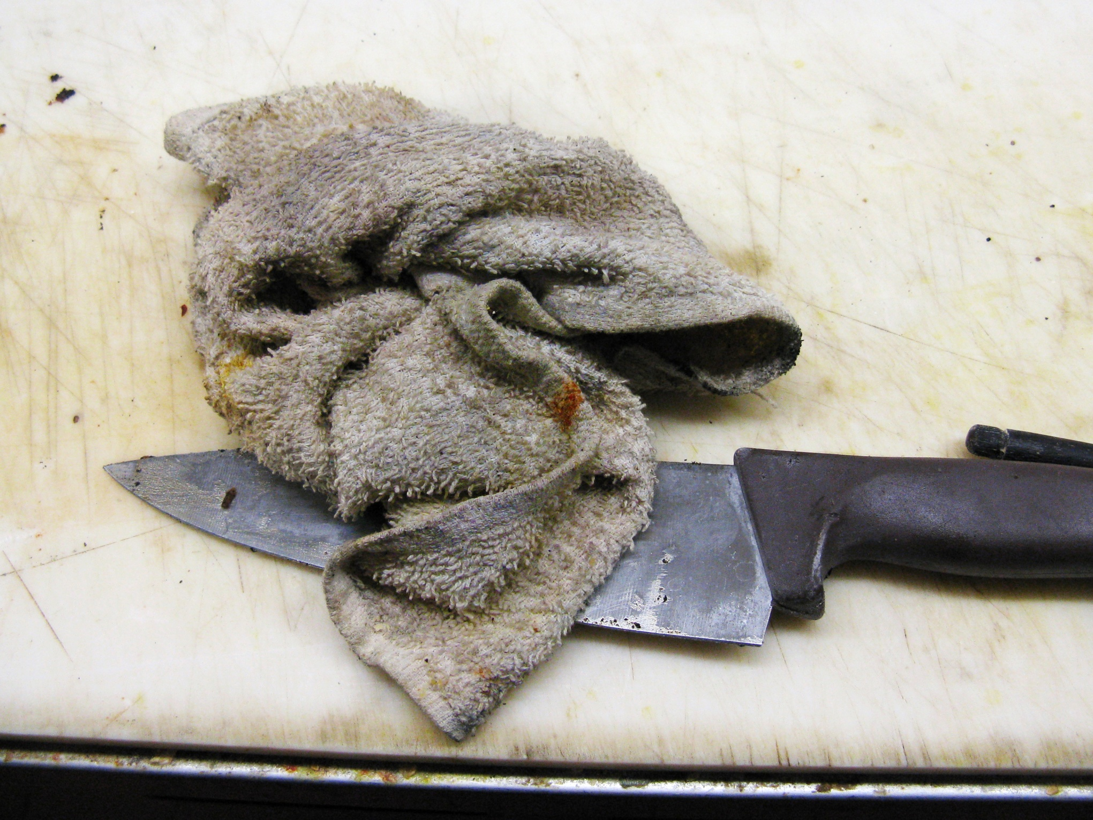
18: 1 of 1
Notes:
This cloth is obviously not acceptable.

Slide 47
What are two ways that heat and chemical sanitizer levels can be tested?

Slide 48
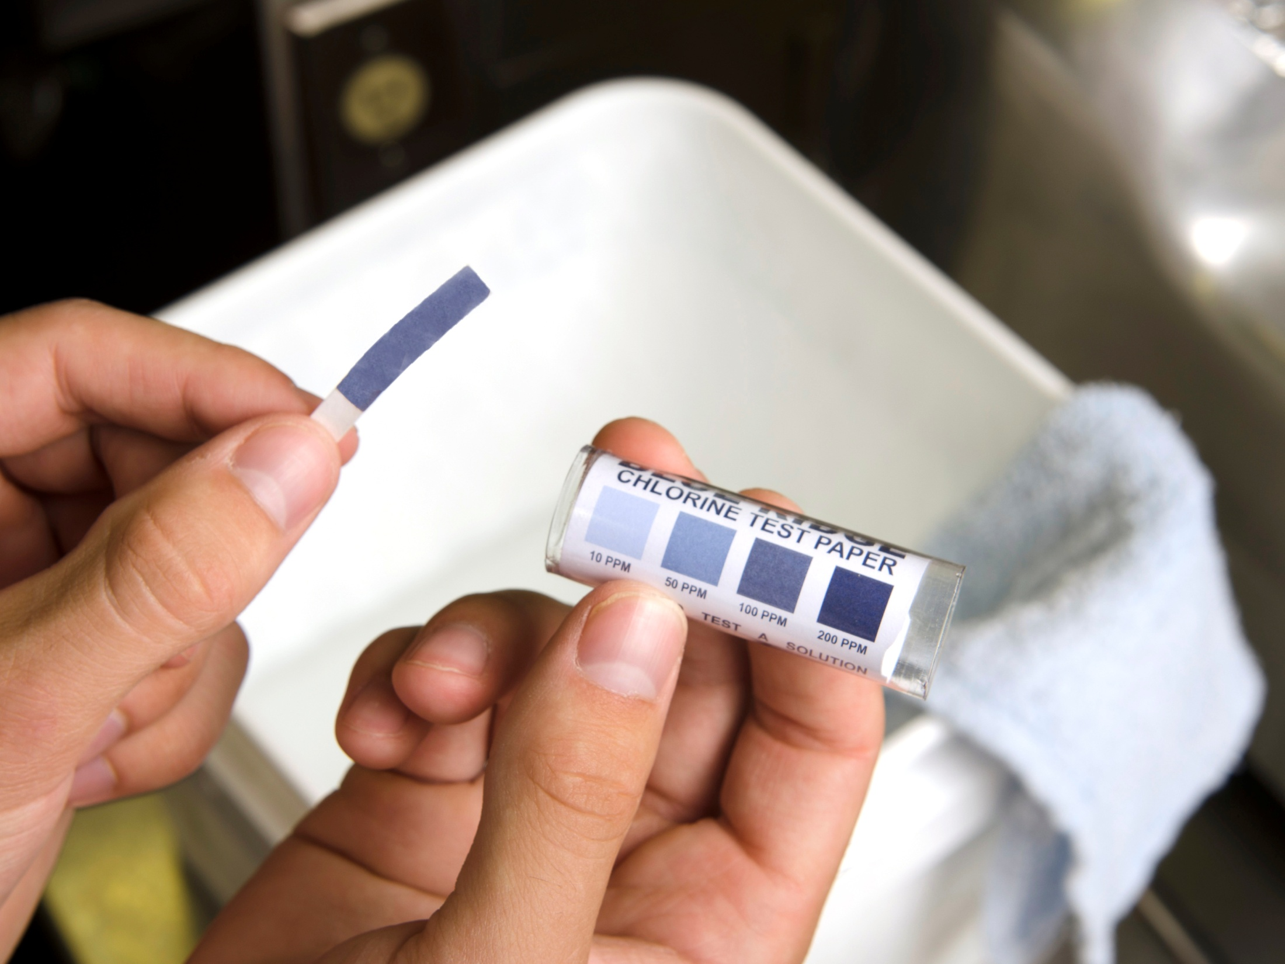
Test Strips
Test Strips and Temperature Gauges
Notes:
Answer: using test strips and temperature gauges.
The picture above shows chlorine test strips. The next picture shows a dishwasher temperature gauge.

Slide 49
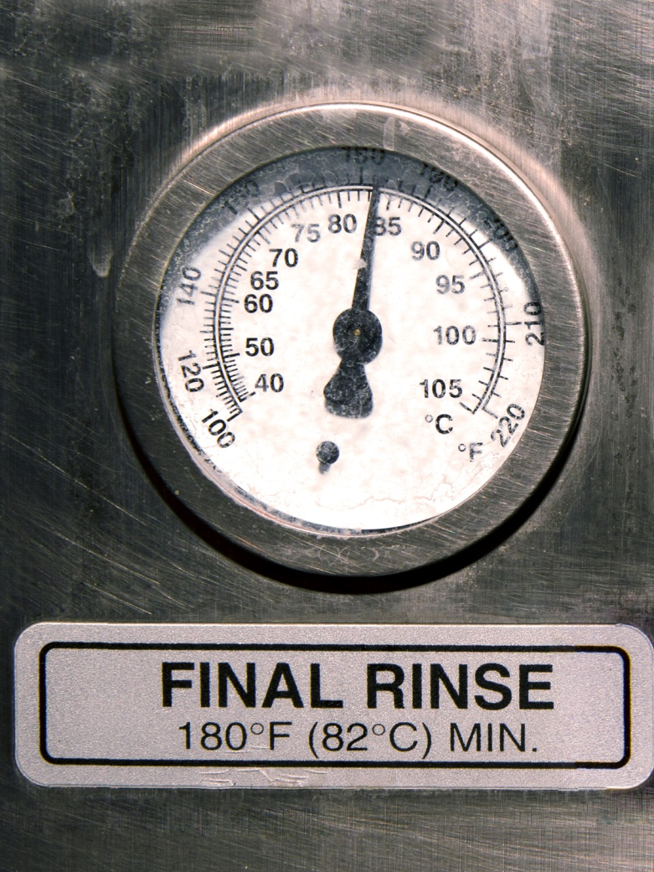
High Temperature Dishwasher Gauge
Dishwasher temperature gauges to be checked daily.
Notes:
The picture is of a high temperature dishwasher gauge.
A dishwasher that uses heat to sanitize (not a chemical) requires a booster heater which heats water to 82°C at the manifold and to at least 71°C at the plate level in order to sanitize dishes. Water heating equipment can fail; therefore, machine gauges indicating water temperatures should be checked at least daily and recorded. It is a good idea to always double check that the temperature gauge is working properly by using a dishwasher thermometer and running it through the dishwasher to check the maximum temperature reached.
Photo © AHS EPH

